Slide 1

Transition to KS2
Grove Lea Primary

Slide 2
This meeting will hopefully provide you with an insight into KS2 and the opportunities and experiences that your child can look forward to. We are all extremely proud of our school and committed to providing the very best possible education for all of our children. We know that Grove Lea Primary is a school where:
School Rights
To keep ourselves and others Safe
To be Respectful
To come to school and Learn
Core Values- Also known as the 4C’s
Courageous
Curious
Caring
Collaborative

Slide 3
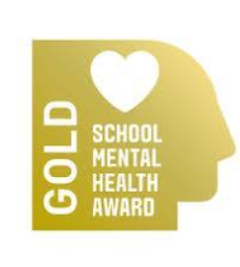
Mental Health and Well-being
At Grove Lea Primary we provide the children with a mental health and wellbeing curriculum. This is delivered through themed sessions each half term.
As a school, we value the importance of MHWB in order to ensure that the children have the best possible chances they need to be safe and happy.
Please follow the link below, which outlines how mental health and wellbeing is embedded into the curriculum as well as additional support that we offer for any children who need it.
Mental Health & Wellbeing @ Grove Lea Primary

Slide 4
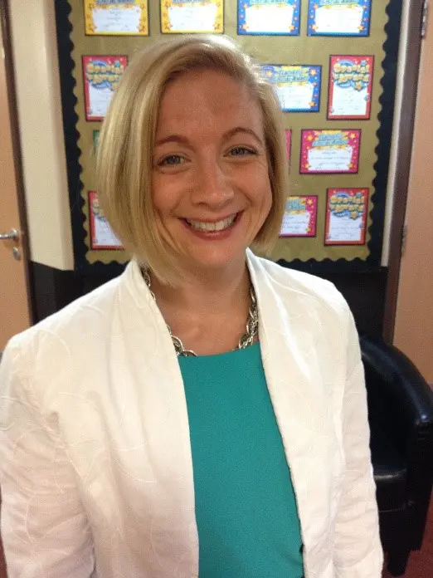
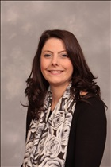
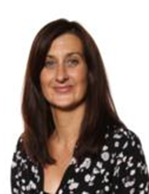

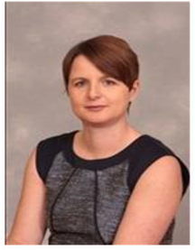
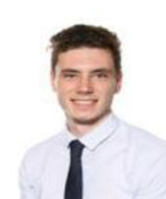
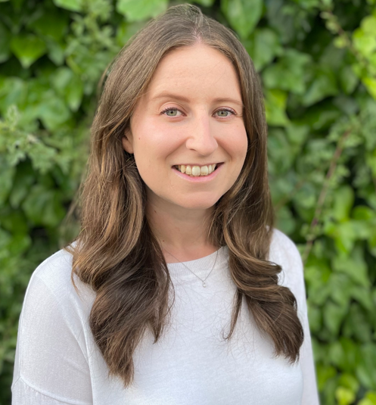
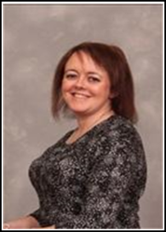
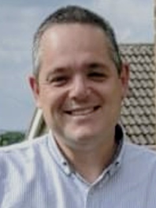
The
Team
Mrs Henshall
Executive Headteacher
Safeguarding
Lead
Miss Litchfield
Learning
Mentor
Mrs Dransfield
SENCO
Mrs Perry Year 3 Teacher
Key stage 2 Leader
Literacy leader
Mrs Wilson
Head of School
KS2 Teacher Assistants
Mrs Weston
Mrs Miller
Mrs Sheridan
Mrs Somerfield
Miss Stevens
Mr Walker
Year 5 Teacher
Leader Music
History and Geography leader
Mr Shackleton
Year 6
Teacher
ICT Leader
Miss Collins
Year 4
Teacher
Miss Barnsley
KS2
HLTA
PSHE leader

Slide 5
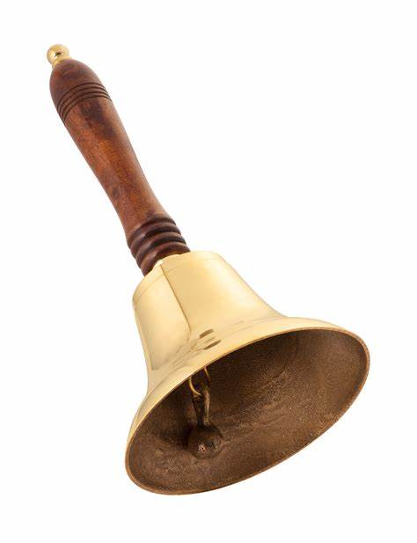
The School Day
School Day: 8:50am—3:20pm
Break: 15 minutes within the am session
Lunch: 1 hour – eat lunch and play
Main difference is a set playtime in the morning with Year 4 and 5
The children will play on the KS2 playground at playtime and at lunch.

Slide 6
Wrap Around Care
Morning Club - This will be a flat rate cost of £3.00 (free for children eligible for Pupil premium). This does include breakfast (toast or cereal). Booking for breakfast club can be done by contacting the school office. The morning club starts at 7.45am and drop off is to the Multipurpose room at the side of school by the staff car park.
After school clubs - These will be curriculum enhancement clubs and run weekly. After school clubs will run in 10 week blocks so please make sure you check the start dates and end dates as they do not run the full term. Clubs will run until 4.30pm and the cost of a 10 week block will be £20 to cover staffing and resources (Pupil Premium children will be entitled to 1 free block). Please keep a look out on Class Dojo in early September for when to sign up.

Slide 7
Curriculum
Children in Key Stage 2 will be participating in well developed curriculum which will include gardening and cooking. They will have daily spelling and whole class guided reading Literacy and maths sessions. ​
Two PE sessions a week​
In addition to their class teacher, they will also work with other adults for different curriculum subjects and interventions.

Slide 8
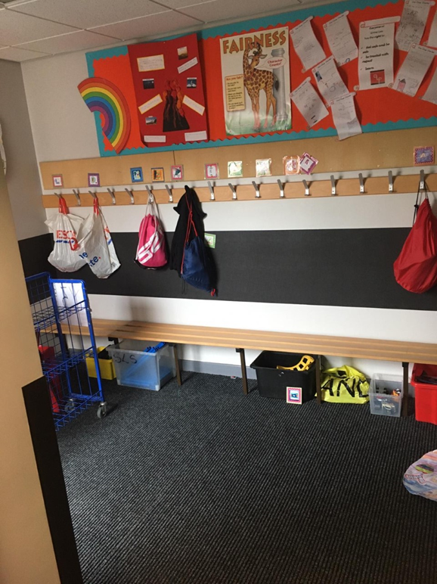
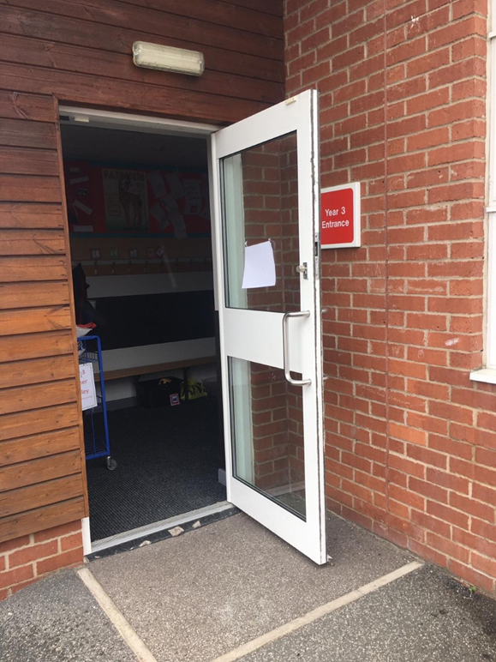
Year 3 cloakroom and outside door

Slide 9
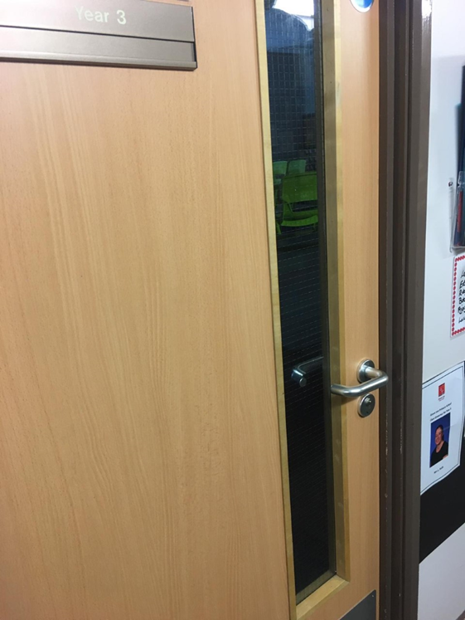
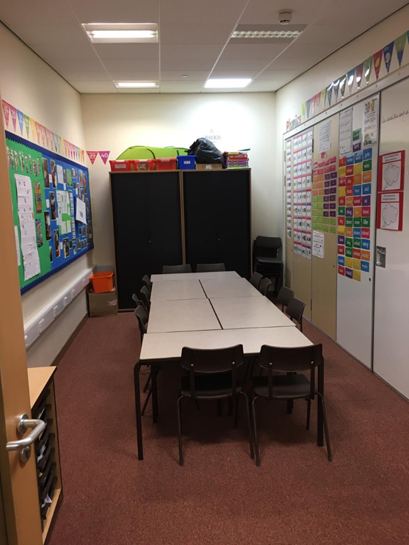
Year 3 entrance and group room

Slide 10
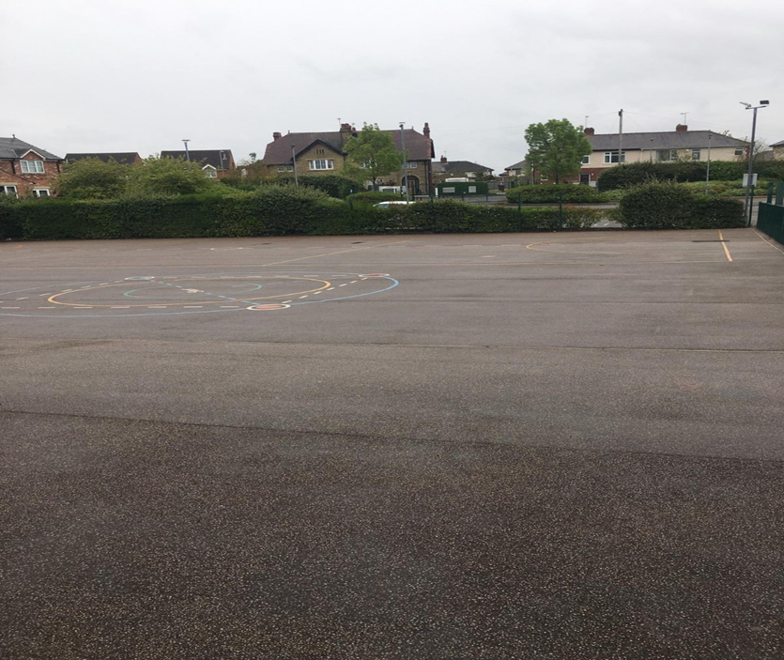
Key stage 2 playground

Slide 11




Behaviour and Discipline
If children do not follow school rules, they will first be reminded of the teacher’s expectations verbally.
If they continue to behave inappropriately, they will be given a second warning and will move onto the amber traffic light.
If children still continue they will receive their final warning and move onto the red traffic light. This will result in them missing their next break time and a dojo being sent home.
If in the event, a child refuses to adhere to classroom rules and sufficient warnings have been given, the child will be asked to work in another supervised area. The child will return once they comply with the teacher’s instructions and guidelines.
Children will return back onto green traffic light in the afternoon
Dojos
Praising Assembly
Weekly certificates
Start dojo certificates
Within Key Stage 2, the children are praised for good behaviour using dojos.
Children are organised into four coloured teams and in praising assembly every Friday, the team from each class that has earned the most dojos displays its ribbons on the class merit cup.
A ‘dojo winner’ from each class is also chosen during the assembly, alongside one weekly award winners for being either caring, curious, collaborative and courageous.

Slide 12
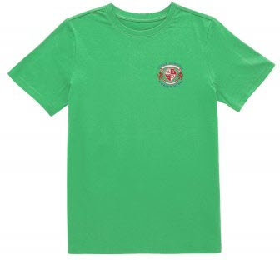


Uniform and Equipment
Water bottle/home school diary/reading book – every day
PE Kit (Indoor & Outdoor/earrings out on PE days/hair tied back) Children will continue to come in PE kit on PE days (2 x in KS1). Replacement t-shirts can be purchased on www.myclothing.com
Uniform – skirts and shorts to be knee length, hair accessories (school colours)
*NEW Plain black leather smart shoe or plain black trainer with no visible logo
Name inside all clothes especially jumpers and cardigans

Slide 13
Work at Home
Daily reading – to support their reading, it is important to encourage your child to read and by recording this information in the planner.
The children are expected to read 4 times a week .
The children are rewarded through the use of dojos
During the school week, your child’s home reading book will be changed once a week and go home on a Friday
Children will be expected to go on Times Table Rockstars at least three times a week.

Slide 14
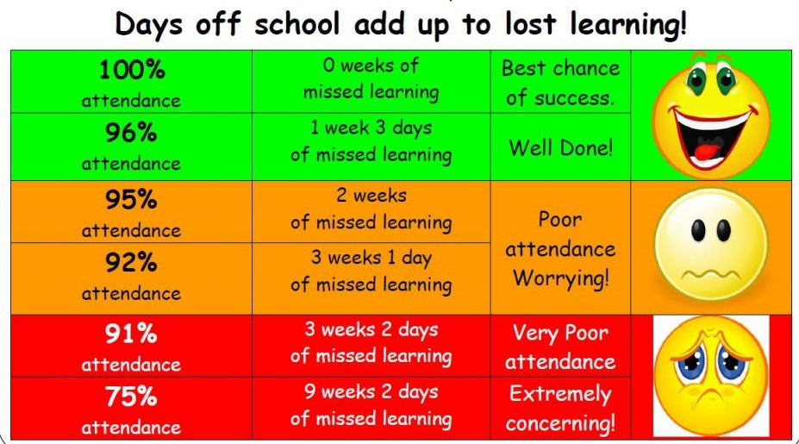
Attendance
It is important that children attend each day to avoid lost learning.
Holidays are not authorised during term time.
It is really important that you contact us if your child is unable to attend a session. If we do not hear from you a member of the team will contact you to ask for a reason for absence.

Slide 15
Medical Needs
Dietary/Medical Requirements:
Please ensure we are informed of
any special dietary requirements, food
allergies or medical needs.
Any changes please let us know ASAP.

Slide 16
Contact numbers and emergencies
Please inform us of any changes to information especially phone numbers. We also require at least 2 emergency contact numbers please.

Slide 17
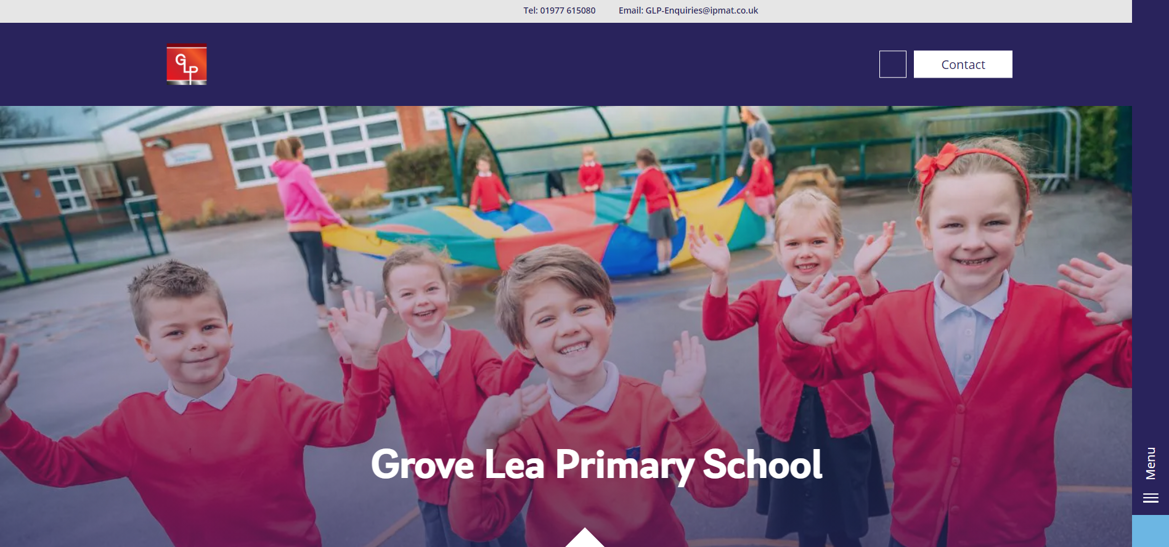



Communication
Dojo – communication with class teacher, daily up dates on progress (Dojo points) and what the class have been doing. Letters also go on here first and dates of events specific to the class such as trips.
School Website – links to subscription sites, any school information, dates for your diary.
Scopay – pay for trips and clubs including breakfast clubs.
School Grid – ordering dinners. Please do so wherever possible and have the discussion with your child so they know what they are going to have.
https://grovelea.ipmat.co.uk/

Slide 18

Thank you!
Any questions?
Please message on Class Dojo

